Slide 1
ENGG7807 Thesis Progress Seminar
Optimisation Super project
Tim Mahoney

Slide 2
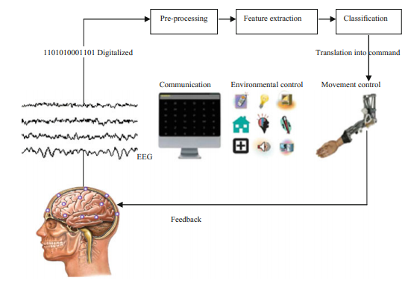
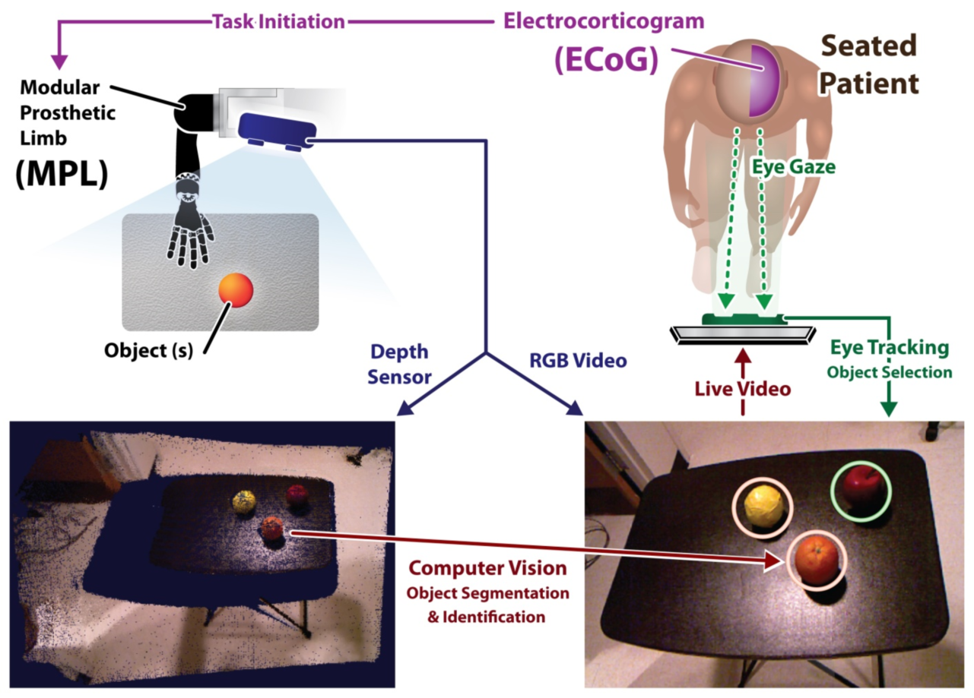
Brain Computer Interfacing

Slide 3
What are the challenges?
Difficult to get clean signal (heaps of noise, non-invasive…)
Hardware requirements – many channels, gell, preporation time
Difficult to classify
We don’t fully understand the brain

Slide 4
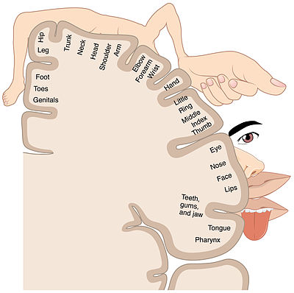
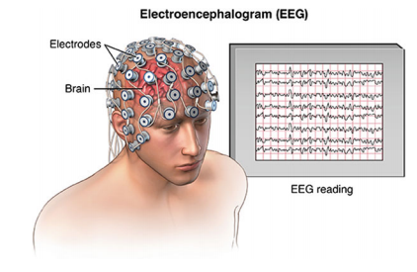
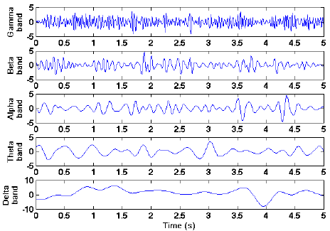
Electroencephalography (EEG)

Slide 5
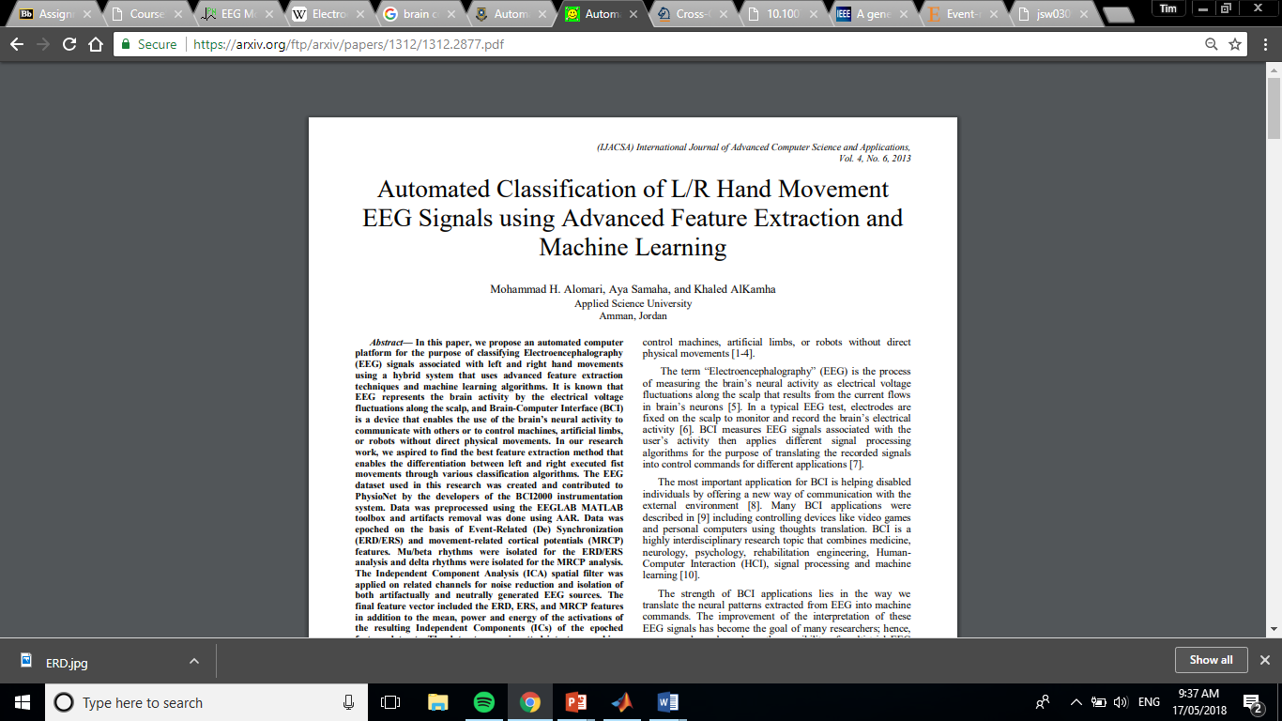
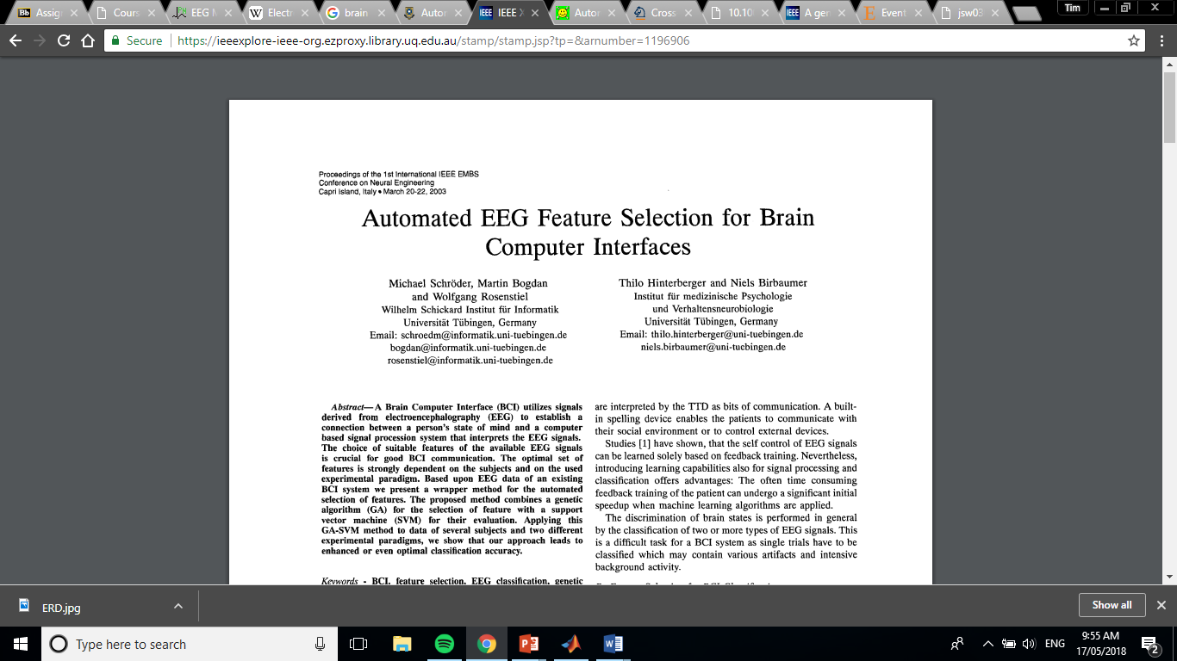
Previous Studies

Slide 6
Feature Selection for Brain Computer Interface using Particle Swarm Optimisation and Genetic Algorithm
Scope:
design for online use
aims to reduce complexity and possibly hardware requirements by only taking information needed to classify signal.
Matlab

Slide 7
Project Timeline
Currently on track:
Preprocessing – complete
Feature Extraction – complete
Feature Selection – research into algorithms and performance indicators complete
Next Step: Implement GA and PSO
Preprocessing
Feature Extraction
Feature Selection
Classification

Slide 8
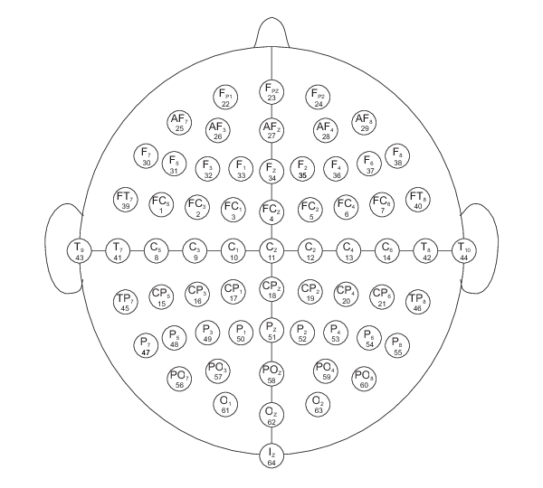
Physionet – EEG Motor Imagery/Movement Dataset
Subjects undertake a number of movement / imagery tasks during EEG recordings
Task 2 – Subject imagines opening/closing left/right fists
109 Subjects, 3x2 minute recordings each with annotations
64 Channel EEG sampled at 160 Hz
The goal is to classify left and right imagery in the EEG data

Slide 9
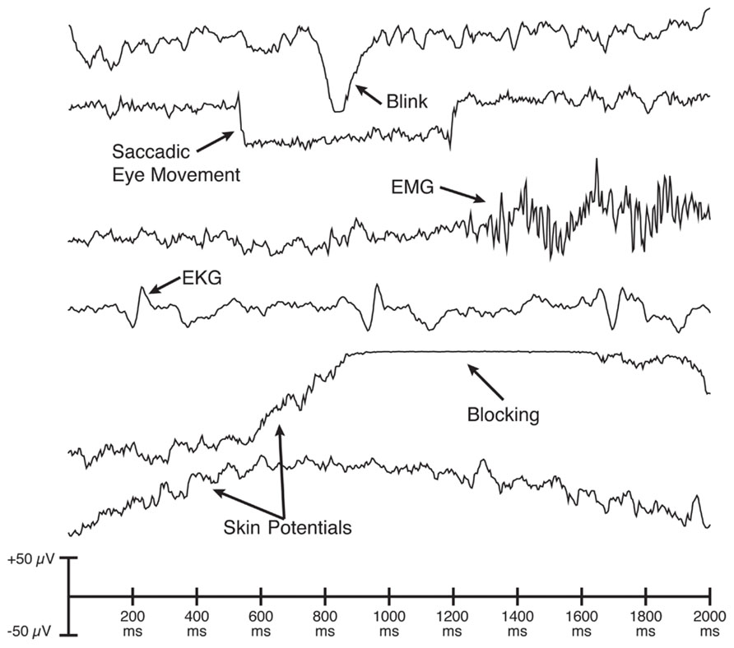
Artefact Removal
Preprocessing
Feature Extraction
Feature Selection
Classification
Examples of EEG artefacts:
Blinks
Electromyography (EMG)
Mains coupling
Electrode shift
Removal techniques:
Epoch removal
Filtering
Independent Component Analysis (ICA)
Automated Artefact Removal (AAR)

Slide 10
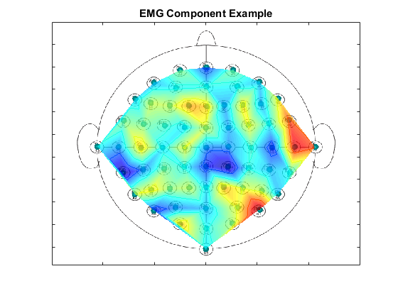
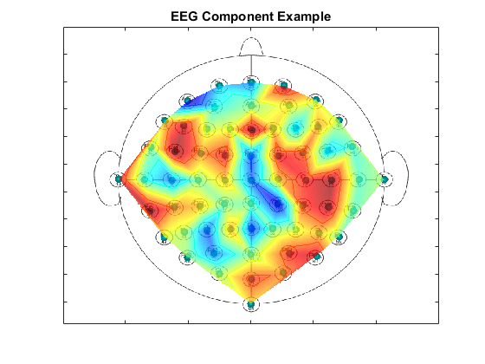
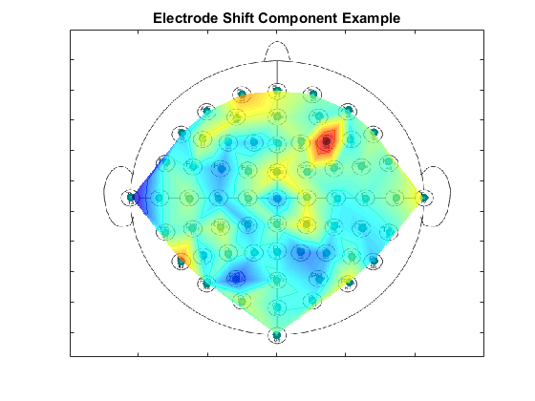
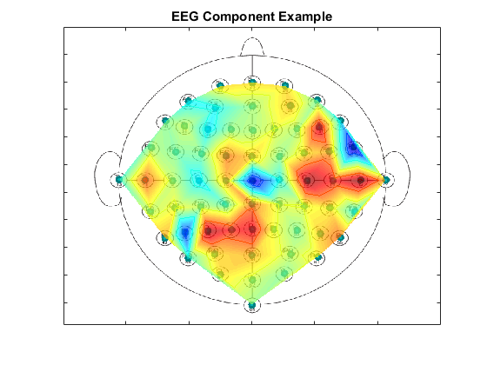
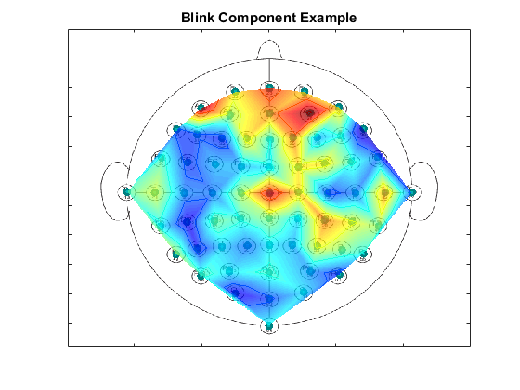
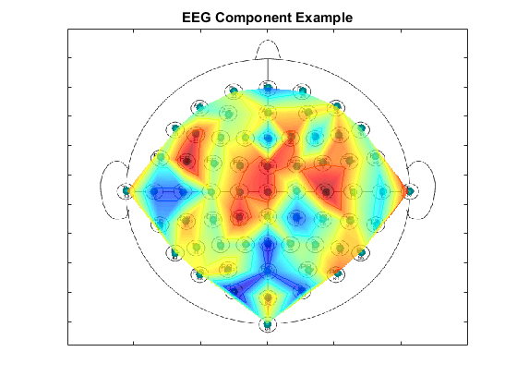
Independent Component Analysis
Voice in a crowd
Labelled 3000 samples PHD candidates helped
Implemented FastICA algorithm on MATLAB

Slide 11
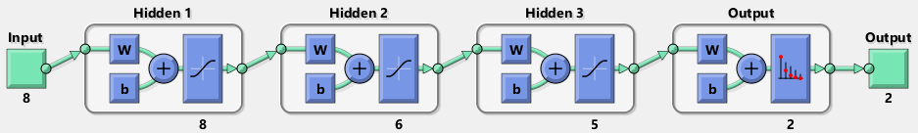
Results
Preprocessing
Feature Extraction
Feature Selection
Classification

Slide 12
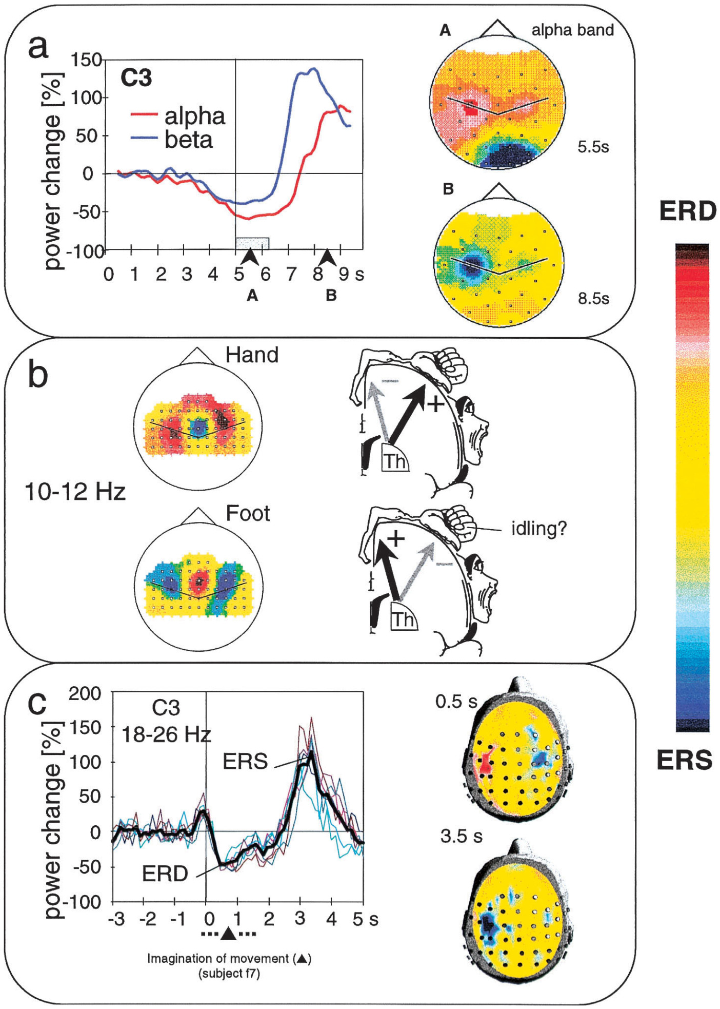
Features
Preprocessing
Feature Extraction
Feature Selection
Classification
Feature Extraction:
Surface Laplacian Transform
Filter into frequency bands
Downsample about event to attain ERD/ERS
Results in 2009 feature long vector
Ch1
alpha
t-2
t-1
beta
Channels
x41
Frequency Bands
x7
Time Samples
x7

Slide 13
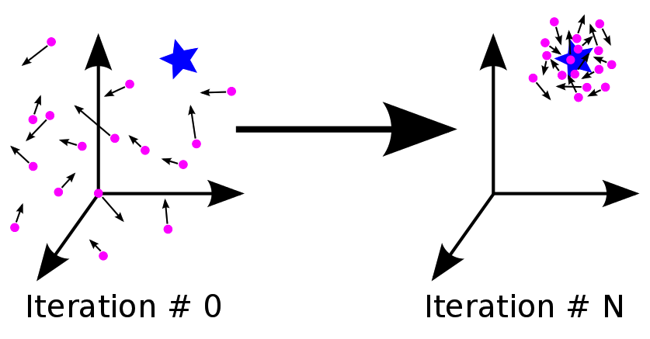
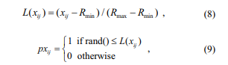
Particle Swarm Optimisation
Preprocessing
Feature Extraction
Feature Selection
Classification
Particles move around the search space toward a heuristic optimum solution to an objective function using communication and memory.
Binary PSO
Wang L, et al. A Novel Probability Binary Particle Swarm Optimisation Algorithm and Its Application, 2008

Slide 14
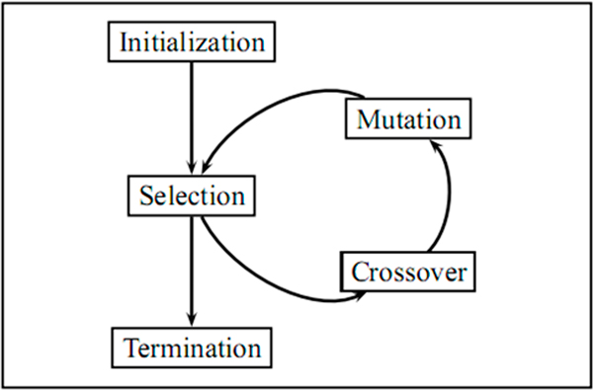
Genetric Algorithm
Preprocessing
Feature Extraction
Feature Selection
Classification
Candidate solutions span the search space by passing on strong binary traits and undergoing mutation with the hope of finding an approximately optimal solution.
Well suited to feature selection applications due to binary nature.

Slide 15
Optimisation Performance
Preprocessing
Feature Extraction
Feature Selection
Classification
Filter method
Performance metrics:
Correlation
Maximum Relevance Minimum Redundancy (MRmR)
Advantages:
Faster
Use with any classifier
Helps in identifying (non)important features

Slide 16
Classifiers
Preprocessing
Feature Extraction
Feature Selection
Classification
Using three classifiers:
Support Vector Machine,
Artificial Neural Network and
Random Forrest
Can be used to compare with previous studies:
Alomari M et al. achieved 97.1% and 86.5% classification accuracy using SVM and ANN on the same dataset!

Slide 17
Further research
Other datasets
Live EEG-BCI data collection
Thankyou for listening!
Questions?

